Slide 1

CALL FOR CODE 2020
Ministry /Organization name : Smartbridge ( Let’s Bridge the Gap )
Project ID : SPS_PRO_215
Internship Title : Predicting the Life Expectancy Using Machine
Learning – SB43733
Problem Statement:
Predicting the Life Expectancy Using Machine Learning.

Slide 2
SOLUTION
For the above problem to get solved we have a dataset consist of various factors. In this system we have taken all the correlated features into consideration. So the target output variable i.e expected life span of the people depends upon variety of factors and not factors of particular fields.
Important immunization like Hepatitis B, Polio and Diphtheria are also considered.
The project uses immunization factors, mortality factors, economic factors, social factors and other health related factors to predict life expectancy of a country for a given year using a machine learning model.
TECHNOLOGY SIMPLIFICATION
Project Requirements: Python, IBM Cloud, IBM Watson;
Functional Requirements: IBM cloud;
Technical Requirements: ML,WATSON STUDIO,PYTHON;
Software Requirements: Watson assistant, PYTHON;

Slide 3
ADVANTAGES
The data-sets are made available to public for the purpose of health data analysis.
Can be used in any organization to analyze the data.
Since the observations this dataset are based on different countries, it will be easier for a country to determine the predicting factor which is contributing to lower value of life expectancy.
Random Forest algorithm is very stable. Even if a new data point is introduced in the dataset, the overall algorithm is not affected much since the new data may impact one tree, but it is very hard for it to impact all the trees.
Applicatons:
As we all know Renewable energy is the future of energy and wind mills is one that would be mostly used as a renewable source of energy because it takes less space as compared to others, more efficient and doesn't harm the environment in any way, that's why this system will be high in demand for cost reduction in construction and maintenance when constructing it according to the whether of the given place and will also help in increasing the efficiency of the energy output
THANKS FOR YOUR TIME

Slide 4
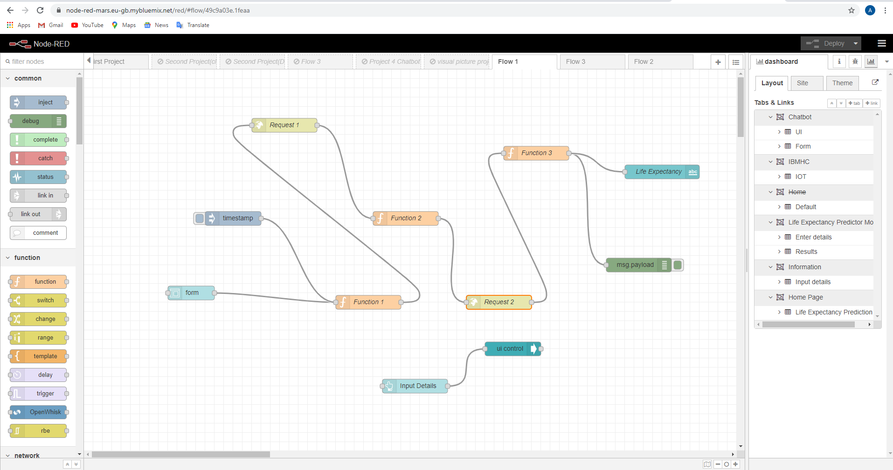
NODERED FLOW:-

Slide 5
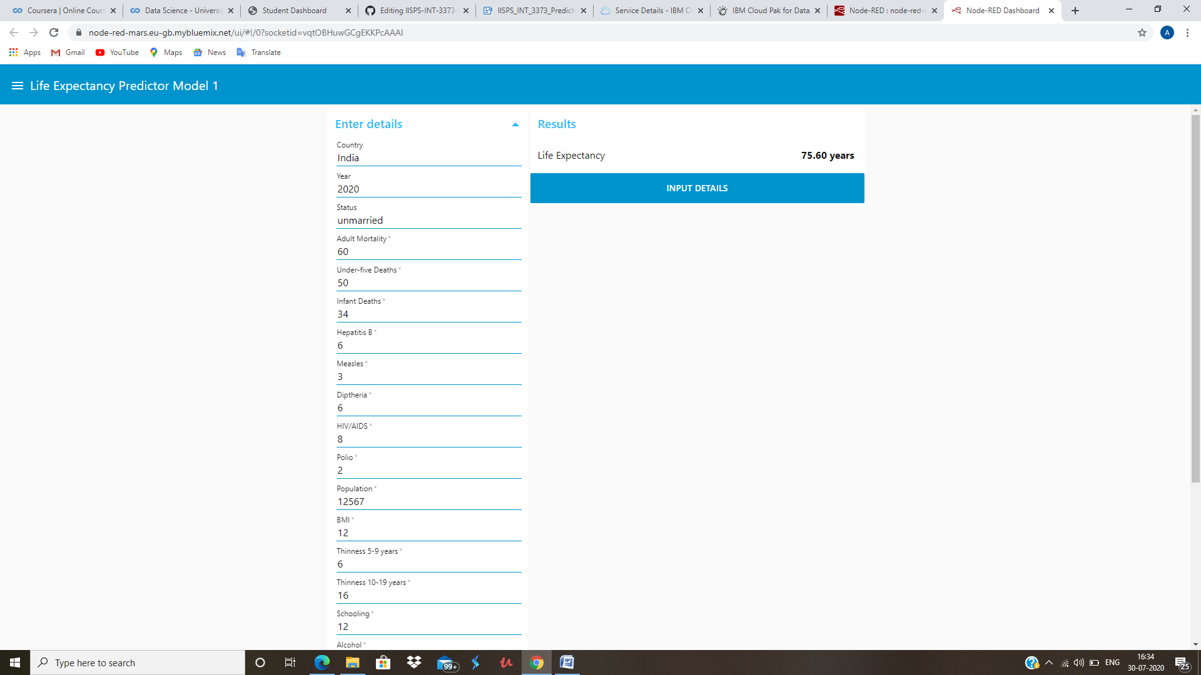
PROJECT OUTPUT:-

Slide 6
CONCLUSION:-
By doing the above procedure and all we successfully created Life expectancy prediction system using IBM Watson studio, Watson machine learning and Node-RED service. The potential use of project is not limited to health care in practice, but could also be useful in other clinical applications such as clinical trials. The project makes a good use of machine learning in predicting life expectancy of a country that can help respective government in making policies that will serve for the benefit of the nation and entire human kind.

